Slide 1


Slide 2

HELPP
Ready To Help!

Slide 3
AIM
To make sure everyone has speedy access in terms of emergency, it is important to manage traffic so as to provide a safe and quick passage for these Vehicle. Helpp! aspires to do the same by digital means.

Slide 4
OVERVIEW
Healthcare and emergency facilities are undoubtedly the basics when it comes to human development. Uninterrupted and timely provision of healthcare services, emergency services like fire brigades and swift disaster management is the key. Everything becomes all the more pertinent when it comes to medical emergency.
We working to provide speedy access to these emergency services, it is important to manage traffic so as to provide a safe and quick passage for ambulances, fire brigades, emergency vehicles.
Helpp app aspires to do the same by digital means such as providing an One Time Password to drivers.
It also help recipients so as to track each other's position and by adding a digital light at traffic lights to signify clearance of passage for emergency vehicles by doing dynamic timing of digital lights to manager traffic.

Slide 5
PROBLEM
Delay In
Service
Information
Loss
Difficult to find location
Traffic Gridlock
HELPP
Ready To Help!

Slide 6
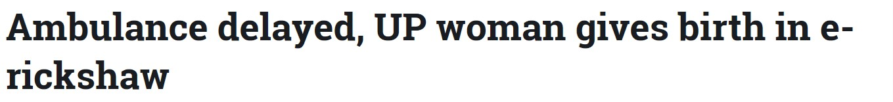

Being in Modern era and still facing problems like this.

Slide 7
IDEA
Basically we are creating an application (named as HELPP temporary) in which when the person in need dial any emergency number either of Ambulance or Fire brigade when contact the person in charge. The person in charge will fill the form in our application with the number the person received call from and the address as given by the person in need. This will generate an one time password which will be then given to the vehicle operator present at that moment. Then the vehicle will be embedded with a GPS in which as soon as one time password is entered the given location will start showing on GPS and driver have to just follow it. The application will also send an message to user with a link in which it can do real time monitoring of the vehicle. Now When in GPS the ambulance will be 1km away from the Traffic light the digital light added in Traffic light will turn into green symbolizing that an emergency vehicle is away at 1km so the public there and police in charge in there can take action to clear the traffic in best possible way. To provide pathway to coming emergency vehicle.

Slide 8
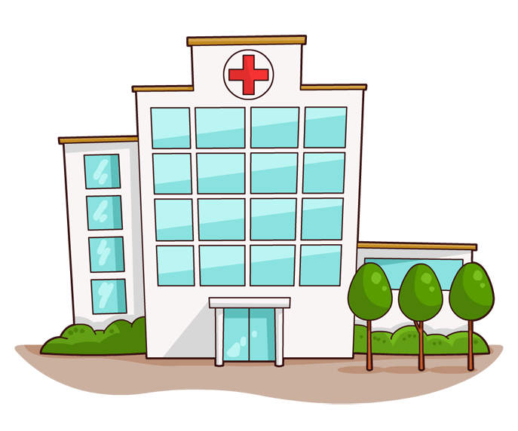


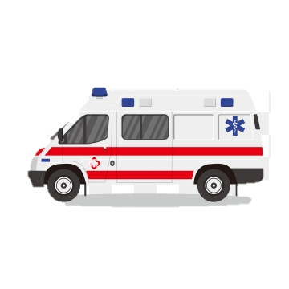
Software Part:-
Mr z
Mr y

Slide 9
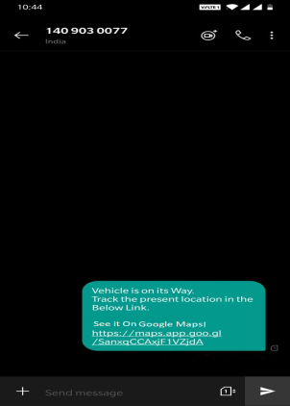
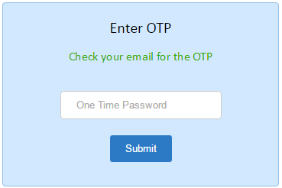
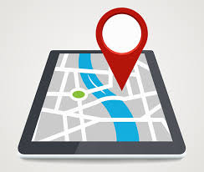
User
Enter OTP
Driver
Open maps

Slide 10
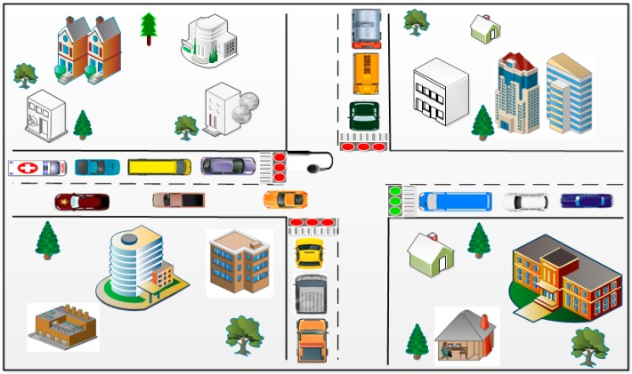
Looking at the present state of practice, the green light sequence is determined without taking the possible presence of emergency vehicles into account. Therefore, emergency vehicles such as ambulances, police cars, fire engines, etc. must wait in traffic.

Slide 11
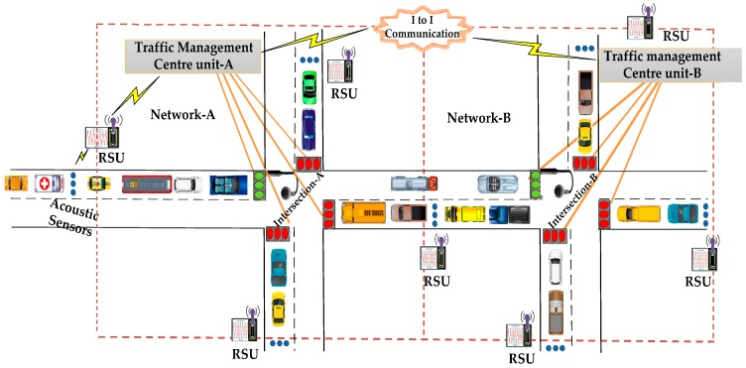
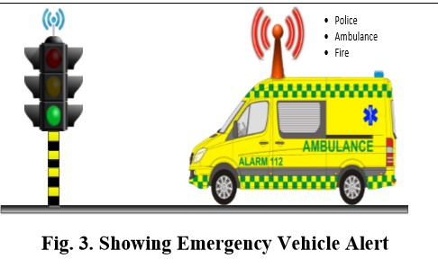
To schedule emergency vehicles in traffic. The approach combines the measurement of the distance between the emergency vehicle and an intersection using visual sensing methods, vehicle counting and time sensitive alert transmission within the sensor network.
Approach
Along with visual sensing techniques to collect emergency vehicle information, it is very important to have a Medium Access Control (MAC) protocol to deliver the emergency vehicle information to the Traffic Management Centre (TMC) with less delay. Then only the emergency vehicle is quickly served and can reach the destination in time.

Slide 12
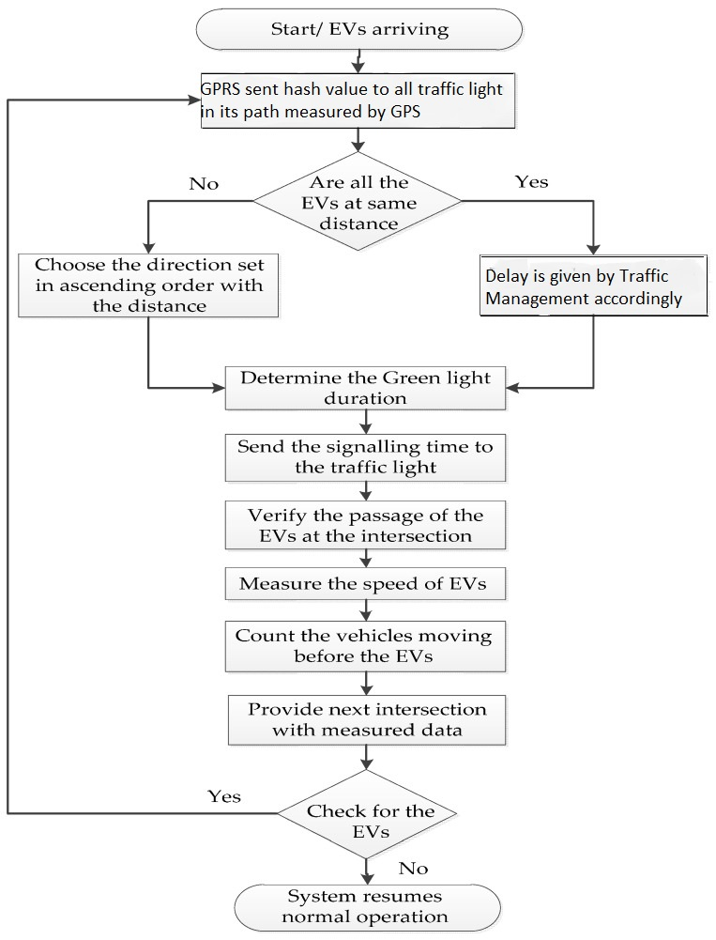
Working Of Traffic Signal
Working Of Traffic Management

Slide 13
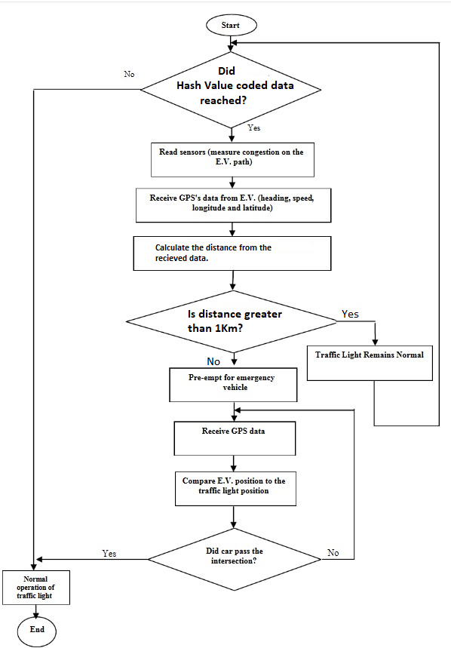
Sensor Working in digital light.

Slide 14
SCOPE
Here the two objectives, that are, first, calculating the density of the vehicle on the road for the flow of the traffic smoothly without congestion and second, developing Priority Based Signalling which will help to give the priority to the emergency vehicles are studied successfully. This Traffic Signal Management approach when properly designed, operated and maintained yields significant benefits like less congestion, saving fuel consumption. The proposed approach will consider not only the priority of the vehicles but also the density of the vehicles on the road and also will control the traffic light sequence efficiently and more accurately and the accuracy of the GPS is more than that of a Camera. This system aims at saving a large amount of man-hours caused by traffic problems and accidents, where prevention can save lives and property. It is able to manage priority emergency tag vehicles.

Slide 15
Business Model
Basic Maintenance income to manage the system and database as well which will be charged per month as per implementation.
2. If private hospital register on our application we will be charging minimum 1000-1500 to get registered on our database.
These is the only profit method (mentioned above) in this and else it will be a non profitable government project used to manage the traffic by taking in consideration emergency vehicle to save lives and property.

Slide 16
TEAM:-Soul Glory
Vikas Rathi
Devesh Goswami
Priyal Jain
Sourabh Tejwani

